Slide 1

Summer Olympics Insights for the new Millenia

Slide 2
Contents
Background
Data
Conclusion & Insights
Objective
Summary
Future insights

Slide 3

Background
Every four years during summer – a city hosts a spectacle like no other with participants from all nations, race & gender represented.
Success at these Olympics depends on certain factors that any nation aspiring for a podium finish in any sports event must hope to replicate.

Slide 4
Objective
We would like to identify factors that influence performance in the Olympics
By looking at the data from all Summer Olympic editions from the 80s’ till date, we aim to show the correlation between the age, gender and sport - in determining the position a nation could end up on the medal table at the end of an edition of the games.

Slide 5
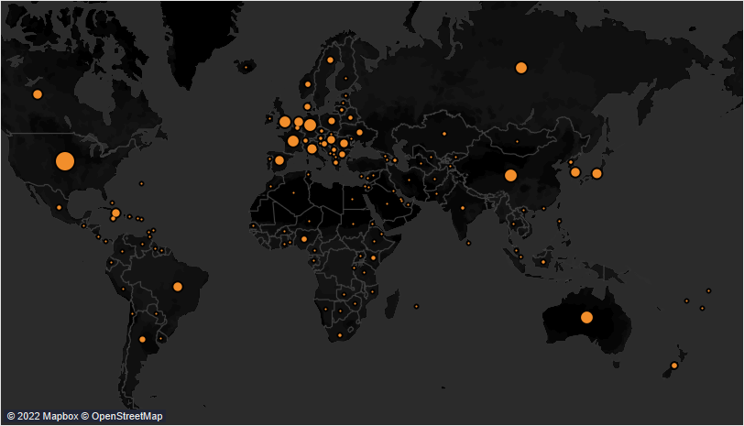
Overall Participation
Over the last 10 editions, nations with more economic power and facilities have been able to get more athletes to represent them at these game
Having more participants generally equate to higher chances of winning a medal and looking at this infographic – it becomes obvious which nations would likely dominate the medal table

Slide 6
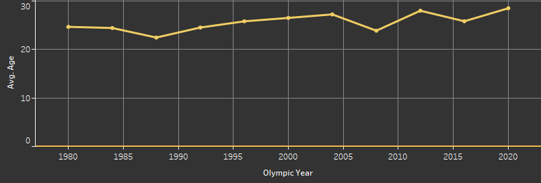
Age Distribution 1980 – 2020 Summer Olympics
The average age for the participation for any of the editions falls within the 20 – 30 years range
In the more recent editions, older participants in the games lead to a higher average age than seen in the previous editions

Slide 7
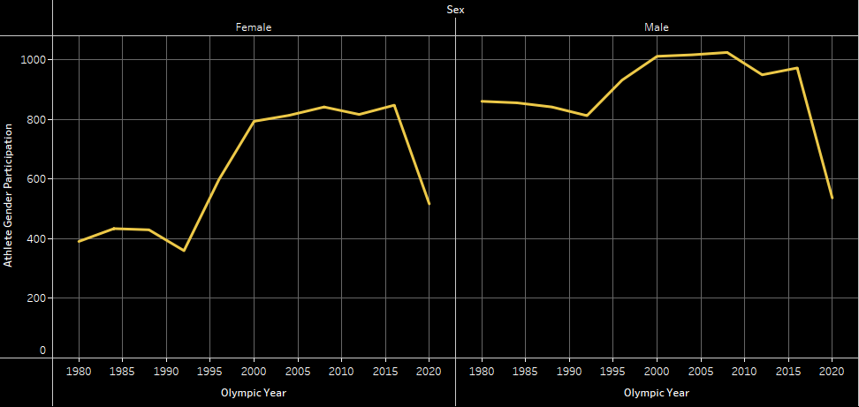
Overall Gender Distribution 1980 – 2020
Female participation between the 1980s and 1990 is much lower when compared to the editions from the 90s onwards
Male participation has been seen a slight increase from the 90s onwards
A sharp decline in participation is seen between the 2016 and 2020 editions
Notes:
Female Rights
Improved consciousness and acceptance of female rights worldwide is mirrored with the increase in female participation at the games. The participation drop at the last edition was due to the COVID epidemic

Slide 8
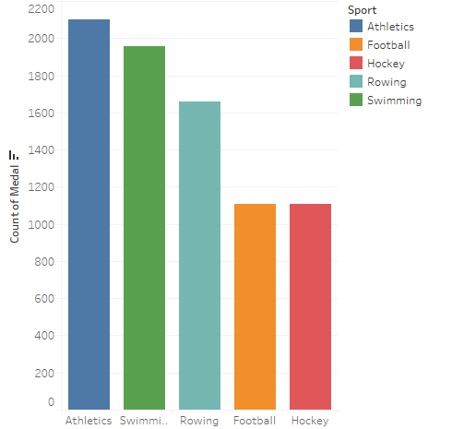
Top Sports By medal
Most of the medals count from top sports are team sports.

Slide 9
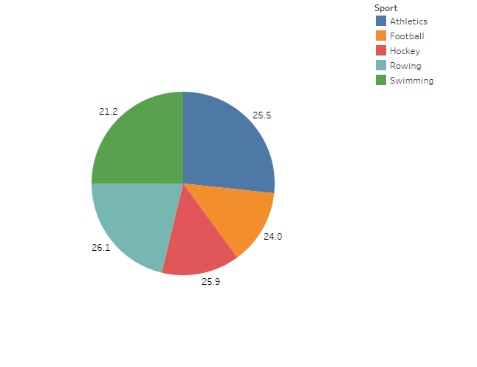
Average age of Athletes in top sports
The average ages of the top sport still reflect the overall data

Slide 10
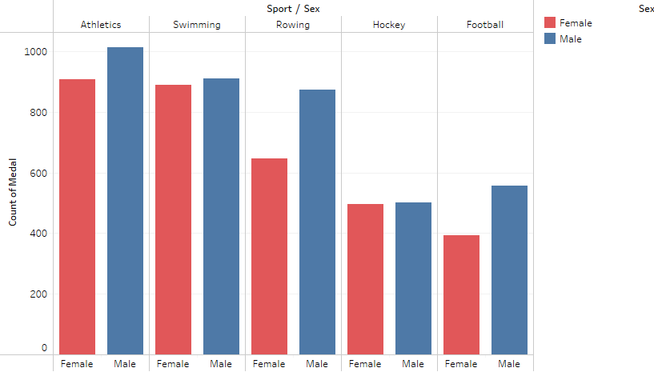
Gender distribution of Athletes in top sports
There is relatively close gender distribution of male and females in the top sports with swimming and hockey having the smallest difference

Slide 11
Summary
102391 athletes who participated in the games between 1980 and 2020 from our cleaned data
20,000+ medals won in that period
The United States of America dominates the medal haul in this period with a total of 1,121 and 441 Gold medals
The Sports with most medals is Athletics - with 2,100 medals available across different team and individual events
Female participation in the Olympics has increased considerably with an increase of about 120% from the 80s to the 90s

Slide 12
Conclusion
Engage athletes in team sports. As it has higher recognition
To perfom sucessfully in the olympics , athletes most be in peak physical condtion which is easier to maintain within the ages of 20 and 30 years
Although male participation is higher in every category, increasing female participation may or may not have a significant impact in success in the Olympics

Slide 13
Future Insights
Economic Factors such as investment in developing sporting activities

Slide 14


Team Presentation
Tunde Obatayo DATA ANALYST
Barrie, ON Canada
Chisom Okere DATA SCIENTIST
Edinburgh, UK

Slide 15
Thank You!

